Slide 2
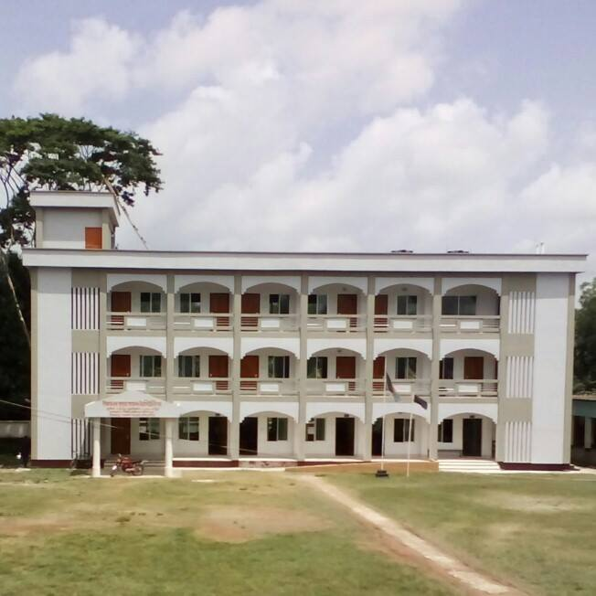
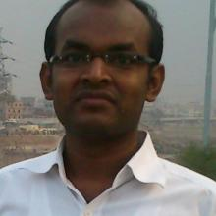
Teacher’s Identity
Shibchar Nanda Kumar Model Instituion
Md. Jasim Madbar
Assistant Teacher
Shibchar Nanda Kumar Model Institution

Slide 3
Class Identity
Class : Viii
Subject : English
Unit : Seven
Lesson : Three
Time : 40 Minutes
Date : 10 March, 2016

Slide 4
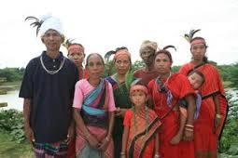
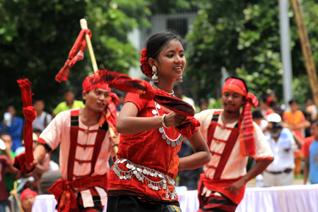
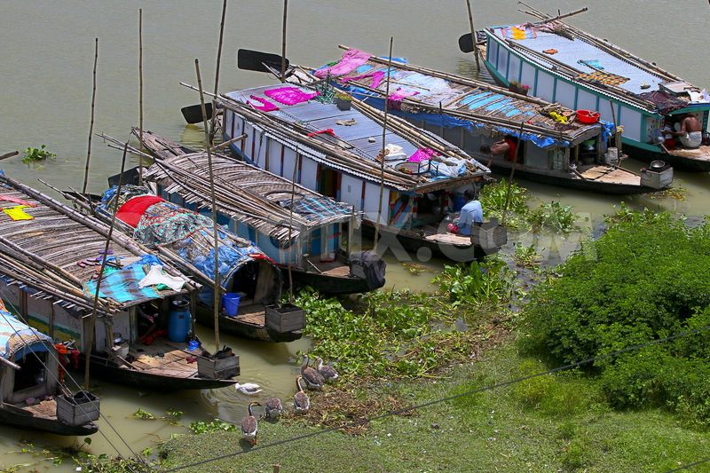
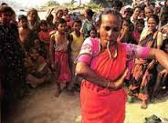
Look at the pictures…
Ethnic people
Gypsies culture
Living place of gypsies
Snake charming
A Glimpse on the Life Style of the Ethnic People

Slide 5
River Gypsies in Bangladesh (1)

Slide 6
Learning Outcomes
By the end of the lesson students will be able to…
Learn new vocabulary
Ask and answer the question
Solve the multiple choice
Make a dialogue (speaking skill)
Write a paragraph (writing skill)

Slide 7
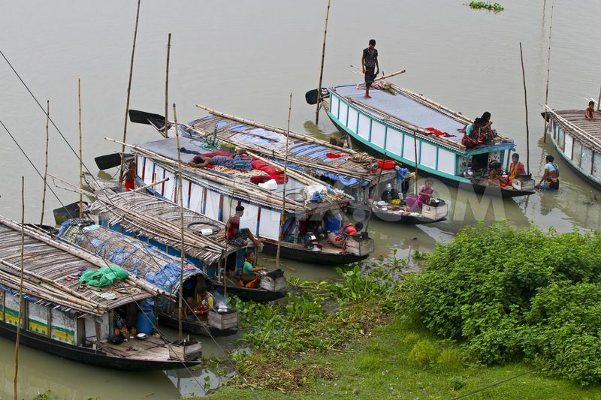
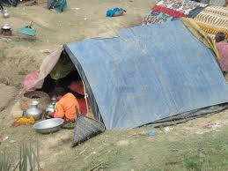
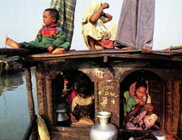
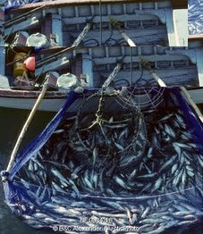
River Gypsies in Bangladesh
Living in boat as don’t own land
In winter, return mainland
Passing time
In monsoon, busy with fishing

Slide 8
Individual Work
Read the text in your book silently.
If you fail, take my help.

Slide 9
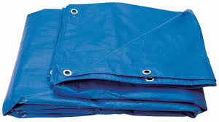
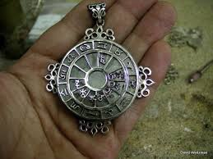
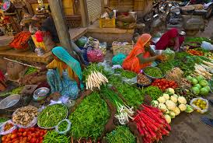
Vocabulary
tarpaulin
A heavy water proof sheet
A magical thing that is remedy for cure
talisman
vend
sell

Slide 10
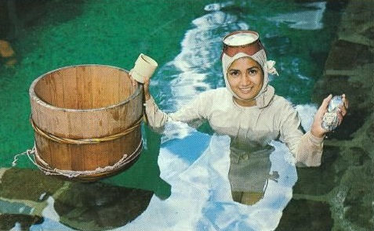
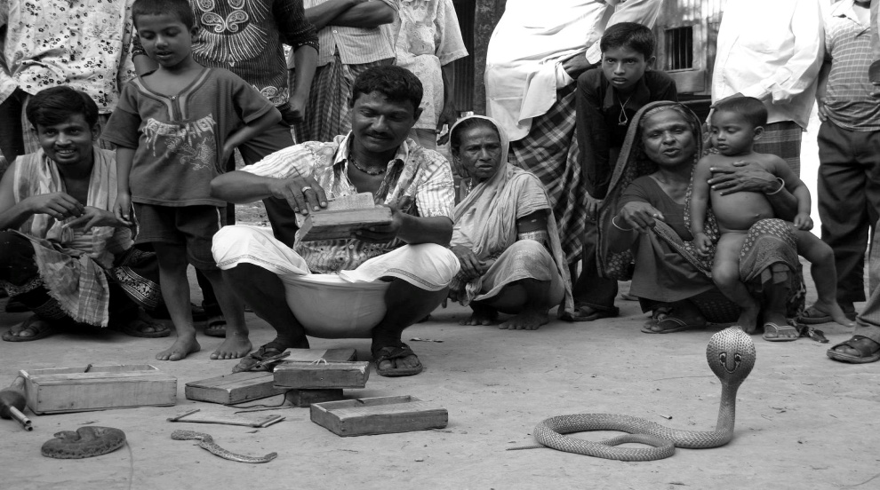
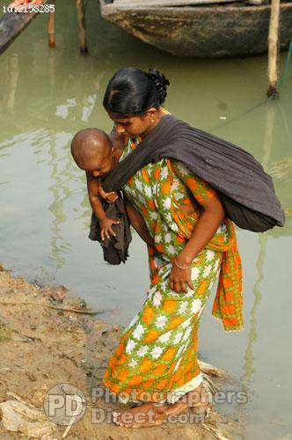
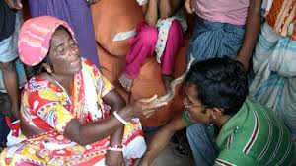
River Gypsy in Bangladesh
Dive for natural pearls
Snake charming
Heal pain & magical power
Selling bangles and cosmetics etc

Slide 11
Individual work
Who are river gypsies?
How do they live?
What do river gypsies do in winter?
What do river gypsy men do for a living?
What do river gypsy women do for a living?

Slide 12
Discuss in group and tick the right answer:
The term ‘ethnic’ is connected with
a. people
b. plants
c. animals
d. fishes
2. River gypsies live in tents in
a. summer
b. winter
c. monsoon
d. spring

Slide 13
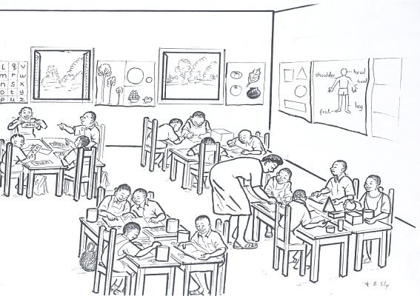
Pair Work
Make a dialogue with your partner about the life of the gypsies.

Slide 14
Home Work
Write a paragraph on River gypsies.

Slide 15
Thanks

